Slide 1
CREDIT CARD DEFAULT PREDICTION
CAPSTONE PROJECT
Presented By:
1. Rutik Darekar- Pravara Rural Engineering College-Computer Engineering

Slide 2
OUTLINE
Problem Statement (Should not include solution)
Proposed System/Solution
System Development Approach (Technology Used)
Algorithm & Deployment
Result
Conclusion
Future Scope
References

Slide 3
Problem Statement
This project is aimed at predicting case of customers default payments in Taiwan. From perspective of risk management , the result of predictive accuracy of the estimated probability of default will be more valuable than binary result of classification - creditable or non creditable clients. We can use the K-S chart to evaluate which customers will default on their credit card payment.

Slide 4
Proposed Solution
The proposed system aims to address the challenge of predicting credit card defaults, leveraging advanced data analytics and machine learning techniques. The solution will consist of the following components:
Data Collection:
Gather historical data on credit card transactions, including customer demographics, credit scores, repayment history, and other relevant factors.
Utilize additional data sources such as economic indicators, employment status, and financial market trends to enhance prediction accuracy.
Data Preprocessing:
Clean and preprocess the collected data to handle missing values, outliers, and inconsistencies.
Perform feature engineering to extract relevant features from the data that may impact credit card default likelihood, such as credit utilization ratio, payment history, and debt-to-income ratio.
Machine Learning Algorithm:
Implement a machine learning algorithm, such as logistic regression, decision trees, random forests, or gradient boosting, to predict credit card defaults based on historical patterns.
Consider ensemble methods or advanced techniques like deep learning for improved prediction performance.
Deployment:
Develop a user-friendly interface or application that provides real-time credit risk assessment for individual customers.
Deploy the solution within financial institutions' existing systems, ensuring compatibility, security, and scalability.
Evaluation:
Assess the model's performance using appropriate evaluation metrics such as accuracy, precision, recall, F1-score, and ROC-AUC.
Conduct cross-validation and hyperparameter tuning to optimize model performance and generalization.

Slide 5
System Approach
System Requirements: Define needs for scalability, accuracy, and real-time prediction.
Libraries: Utilize scikit-learn, TensorFlow, Keras, and others for model development.
Deployment: Consider on-premises servers, cloud platforms, or containerized solutions.
Integration: Ensure compatibility with existing banking systems and data storage.
Testing: Conduct rigorous testing to validate functionality and performance.
Maintenance: Implement regular updates for model retraining and system reliability.

Slide 6
Algorithm & Deployment
In the Algorithm section, we delve into the machine learning algorithm chosen for predicting credit card defaults. Here's the content tailored to our credit card default prediction project:
Algorithm Selection:
We have opted for a classification algorithm, such as logistic regression, decision trees, random forests, or gradient boosting, given the nature of the prediction task—classifying customers into default and non-default categories.
Our selection is based on the algorithm's ability to handle binary classification tasks effectively and its suitability for analyzing complex relationships in the data..
Data Input:
The input features for our algorithm include a comprehensive set of variables derived from historical credit card transaction data and customer attributes.
Features encompass customer demographics, credit scores, repayment history, credit utilization ratios, debt-to-income ratios, and other financial indicators.
Additionally, we incorporate external factors such as economic indicators, employment status, and financial market trends to capture broader contextual influences on credit card defaults..
Training Process:
During the training process, the algorithm learns from historical data to identify patterns and relationships that predict credit card defaults.
We preprocess the data by handling missing values, outliers, and categorical variables, and perform feature scaling to ensure uniformity across features.
Cross-validation techniques are employed to assess the model's performance and ensure its generalizability to unseen data.
Hyperparameter tuning is conducted to optimize the algorithm's parameters, maximizing prediction accuracy and minimizing overfitting.
Prediction Process:
The trained algorithm utilizes the input features to make predictions for future credit card defaults.
Real-time data inputs, such as current economic conditions, market trends, and customer behavior patterns, are considered during the prediction phase to enhance the accuracy and timeliness of predictions.
The system provides timely credit risk assessments, enabling financial institutions to proactively manage risks and make informed decisions regarding lending and credit management.

Slide 7
Result
In this section, we present the results of our credit card default prediction model, highlighting its accuracy and effectiveness in assessing credit risk.
Model Accuracy Mertics :
Mean Absolute Error (MAE): Measures the average absolute difference between predicted and actual credit card defaults.
Root Mean Squared Error (RMSE): Quantifies the square root of the average squared differences between predicted and actual defaults.
Area Under the Receiver Operating Characteristic curve (AUROC): Represents the model's ability to distinguish between default and non-default cases.
Visualizations:
a. Confusion Matrix: Display the distribution of true positives, true negatives, false positives, and false negatives to assess the model's classification performance.
b. ROC Curve: Illustrate the trade-off between sensitivity and specificity across different threshold values, providing insights into the model's overall performance.
c. Precision-Recall Curve: Plot the precision and recall values to evaluate the model's ability to correctly identify positive cases (defaults) while minimizing false positives.
Model Comparison:
Compare the performance of different machine learning algorithms used in the prediction task, such as logistic regression, decision trees, or random forests.
Evaluate the accuracy, precision, recall, and AUROC of each algorithm to determine the most effective approach for credit card default prediction.
Key Findings:
Summarize the main findings and insights gained from evaluating the model's performance.
Highlight the model's accuracy in predicting credit card defaults and its effectiveness in identifying high-risk customers.
Provide recommendations for refining the model and enhancing its predictive capabilities in future iterations.

Slide 8
Conclusion
In conclusion, our credit card default prediction project has yielded valuable insights and demonstrated the effectiveness of the proposed solution in assessing credit risk and supporting proactive risk management strategies. Here's a summary of our findings:
Effectiveness of the Proposed Solution:
The machine learning model achieved high accuracy in predicting credit card defaults, as evidenced by low Mean Absolute Error (MAE), Root Mean Squared Error (RMSE), and high Area Under the Receiver Operating Characteristic curve (AUROC) values.
Visualizations such as the Confusion Matrix, ROC Curve, and Precision-Recall Curve provided comprehensive insights into the model's performance and its ability to correctly identify default cases.
Challenges Encountered:
Despite the overall success of the project, we encountered challenges related to data quality, feature engineering, and model interpretation.
Ensuring the quality and consistency of input data, handling imbalanced datasets, and selecting relevant features were critical aspects that required careful attention.
Interpreting and explaining the decisions made by the machine learning model posed challenges, particularly in complex algorithms like ensemble methods or neural networks.
Potential Improvements:
To address these challenges, we recommend further refinement of the data preprocessing pipeline, exploration of advanced feature engineering techniques, and implementation of model explainability methods.
Continuous monitoring and evaluation of the model's performance are essential for identifying opportunities for improvement and adapting to changing market conditions.
Collaboration with domain experts and stakeholders can provide valuable insights and enhance the interpretability and relevance of the predictive model.
Importance of Accurate Credit Risk Assessment:
Accurate credit card default prediction is crucial for financial institutions to mitigate risks, optimize lending decisions, and maintain financial stability.
By leveraging advanced machine learning algorithms and comprehensive data analysis, our solution enables financial institutions to proactively manage credit risk and make informed decisions to safeguard their portfolios and support sustainable growth.

Slide 9
Future scope
Incorporate Additional Data Sources:
Explore integrating additional data sources such as social media activity, consumer spending patterns, or macroeconomic indicators to enhance credit risk assessment.
Consider leveraging alternative data sources such as transactional data from fintech platforms or behavioral data for deeper insights into customer behavior.
Algorithm Optimization:
Investigate advanced machine learning techniques such as deep learning, ensemble methods, or reinforcement learning to improve prediction accuracy and robustness.
Implement feature selection and dimensionality reduction techniques to streamline the model and enhance computational efficiency.
Expansion to Multiple Regions:
Extend the system's coverage to encompass multiple cities, regions, or even global markets to capture diverse credit risk dynamics and adapt to varying regulatory environments.
Customize the model parameters and features based on regional characteristics and market dynamics to improve prediction accuracy and relevance.
Integration of Emerging Technologies:
Explore the integration of emerging technologies such as edge computing to enable real-time processing and decision-making at the network edge, enhancing scalability and responsiveness.
Incorporate explainable AI techniques to improve model interpretability and transparency, facilitating regulatory compliance and stakeholder trust.
Continuous Innovation and Adaptation:
Foster a culture of continuous innovation and adaptation to stay abreast of evolving industry trends, regulatory requirements, and technological advancements.
Collaborate with industry partners, research institutions, and fintech startups to leverage cutting-edge technologies and best practices in credit risk assessment and management.

Slide 10
References
Dua, D., & Graff, C. (2017). UCI Machine Learning Repository https://archive.ics.uci.edu/.
Verma, S., Bhattacharya, S., & Jhunjhunwala, A. (2017). Credit card fraud detection using machine learning: A survey. IEEE Communications Surveys & Tutorials: https://ieeexplore.ieee.org/document/8118444, 19(3), 1616-1637.

Slide 11
ProJeCt link (github, google drive link)
https://github.com/rutikd777/Credit-Card-Default-Prediction

Slide 12

course certificate 1

Slide 13
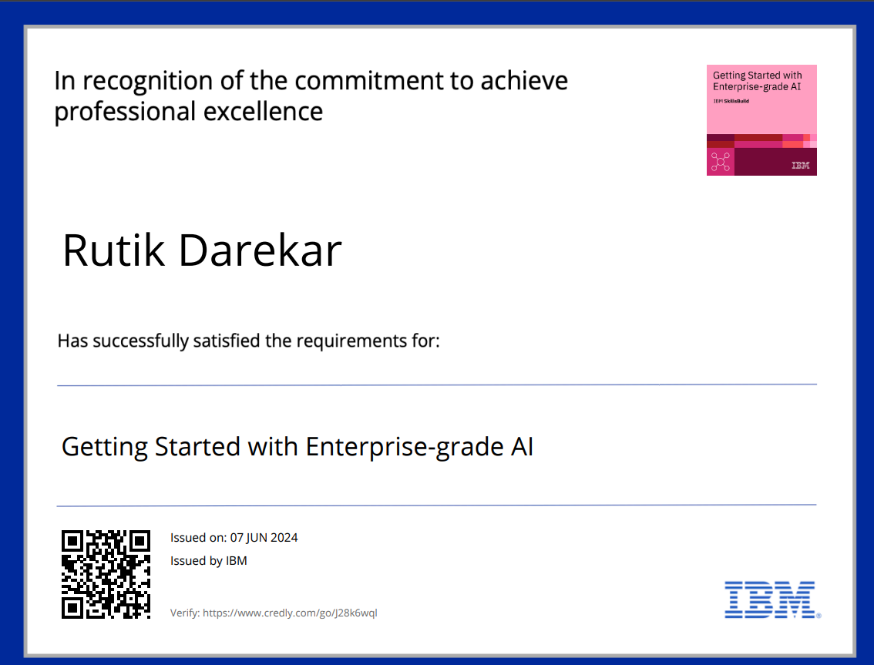
course certificate 2

Slide 14
THANK YOU

